Slide 1
Bad
BAD THINGS DO HAPPEN TO GOOD PEOPLE.
MATTHEW S. COLES, ESQ.
770-995-5578
COLES BARTON LLP
For 30 years Representing the Specialty of Oral Surgery
150 SOUTH PERRY ST.
SUITE 100
LAWRENCEVILLE GA. 30046

Slide 2
TIPS TO DECREASE CHANCE
OF BEING
NAMED IN A LAWSUIT, AND
HOW TO SURVIVE
IF YOU ARE NAMED
Risk Management for the OMS.
August 13, 2017

Slide 3
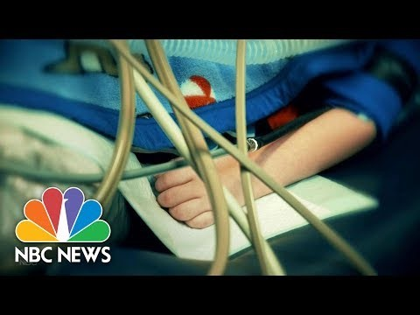
“After several recent tragic cases, there are demands for different practices from the influential American Academy of Pediatrics, according to a report by NBC News national correspondent Kate Snow, which first aired on ‘Sunday Night with Megyn Kelly.’
Dr. Wendy Sue Swanson of Seattle Children's Hospital and a spokesperson from the influential pediatricians group is sounding the alarm about sedating children for oral surgery.
…
It's unclear how many children — or adults, in general — have died in the U.S. during dental procedures. The state boards that oversee dental practice in America usually don’t make that kind of information public.
…
According to a Dallas Morning News investigation in 2015, a dental patient dies nearly every other day in the United States. That’s more than 1,000 people over the course of five-and-a-half years.” (Linda Carroll, TODAY)

Slide 7
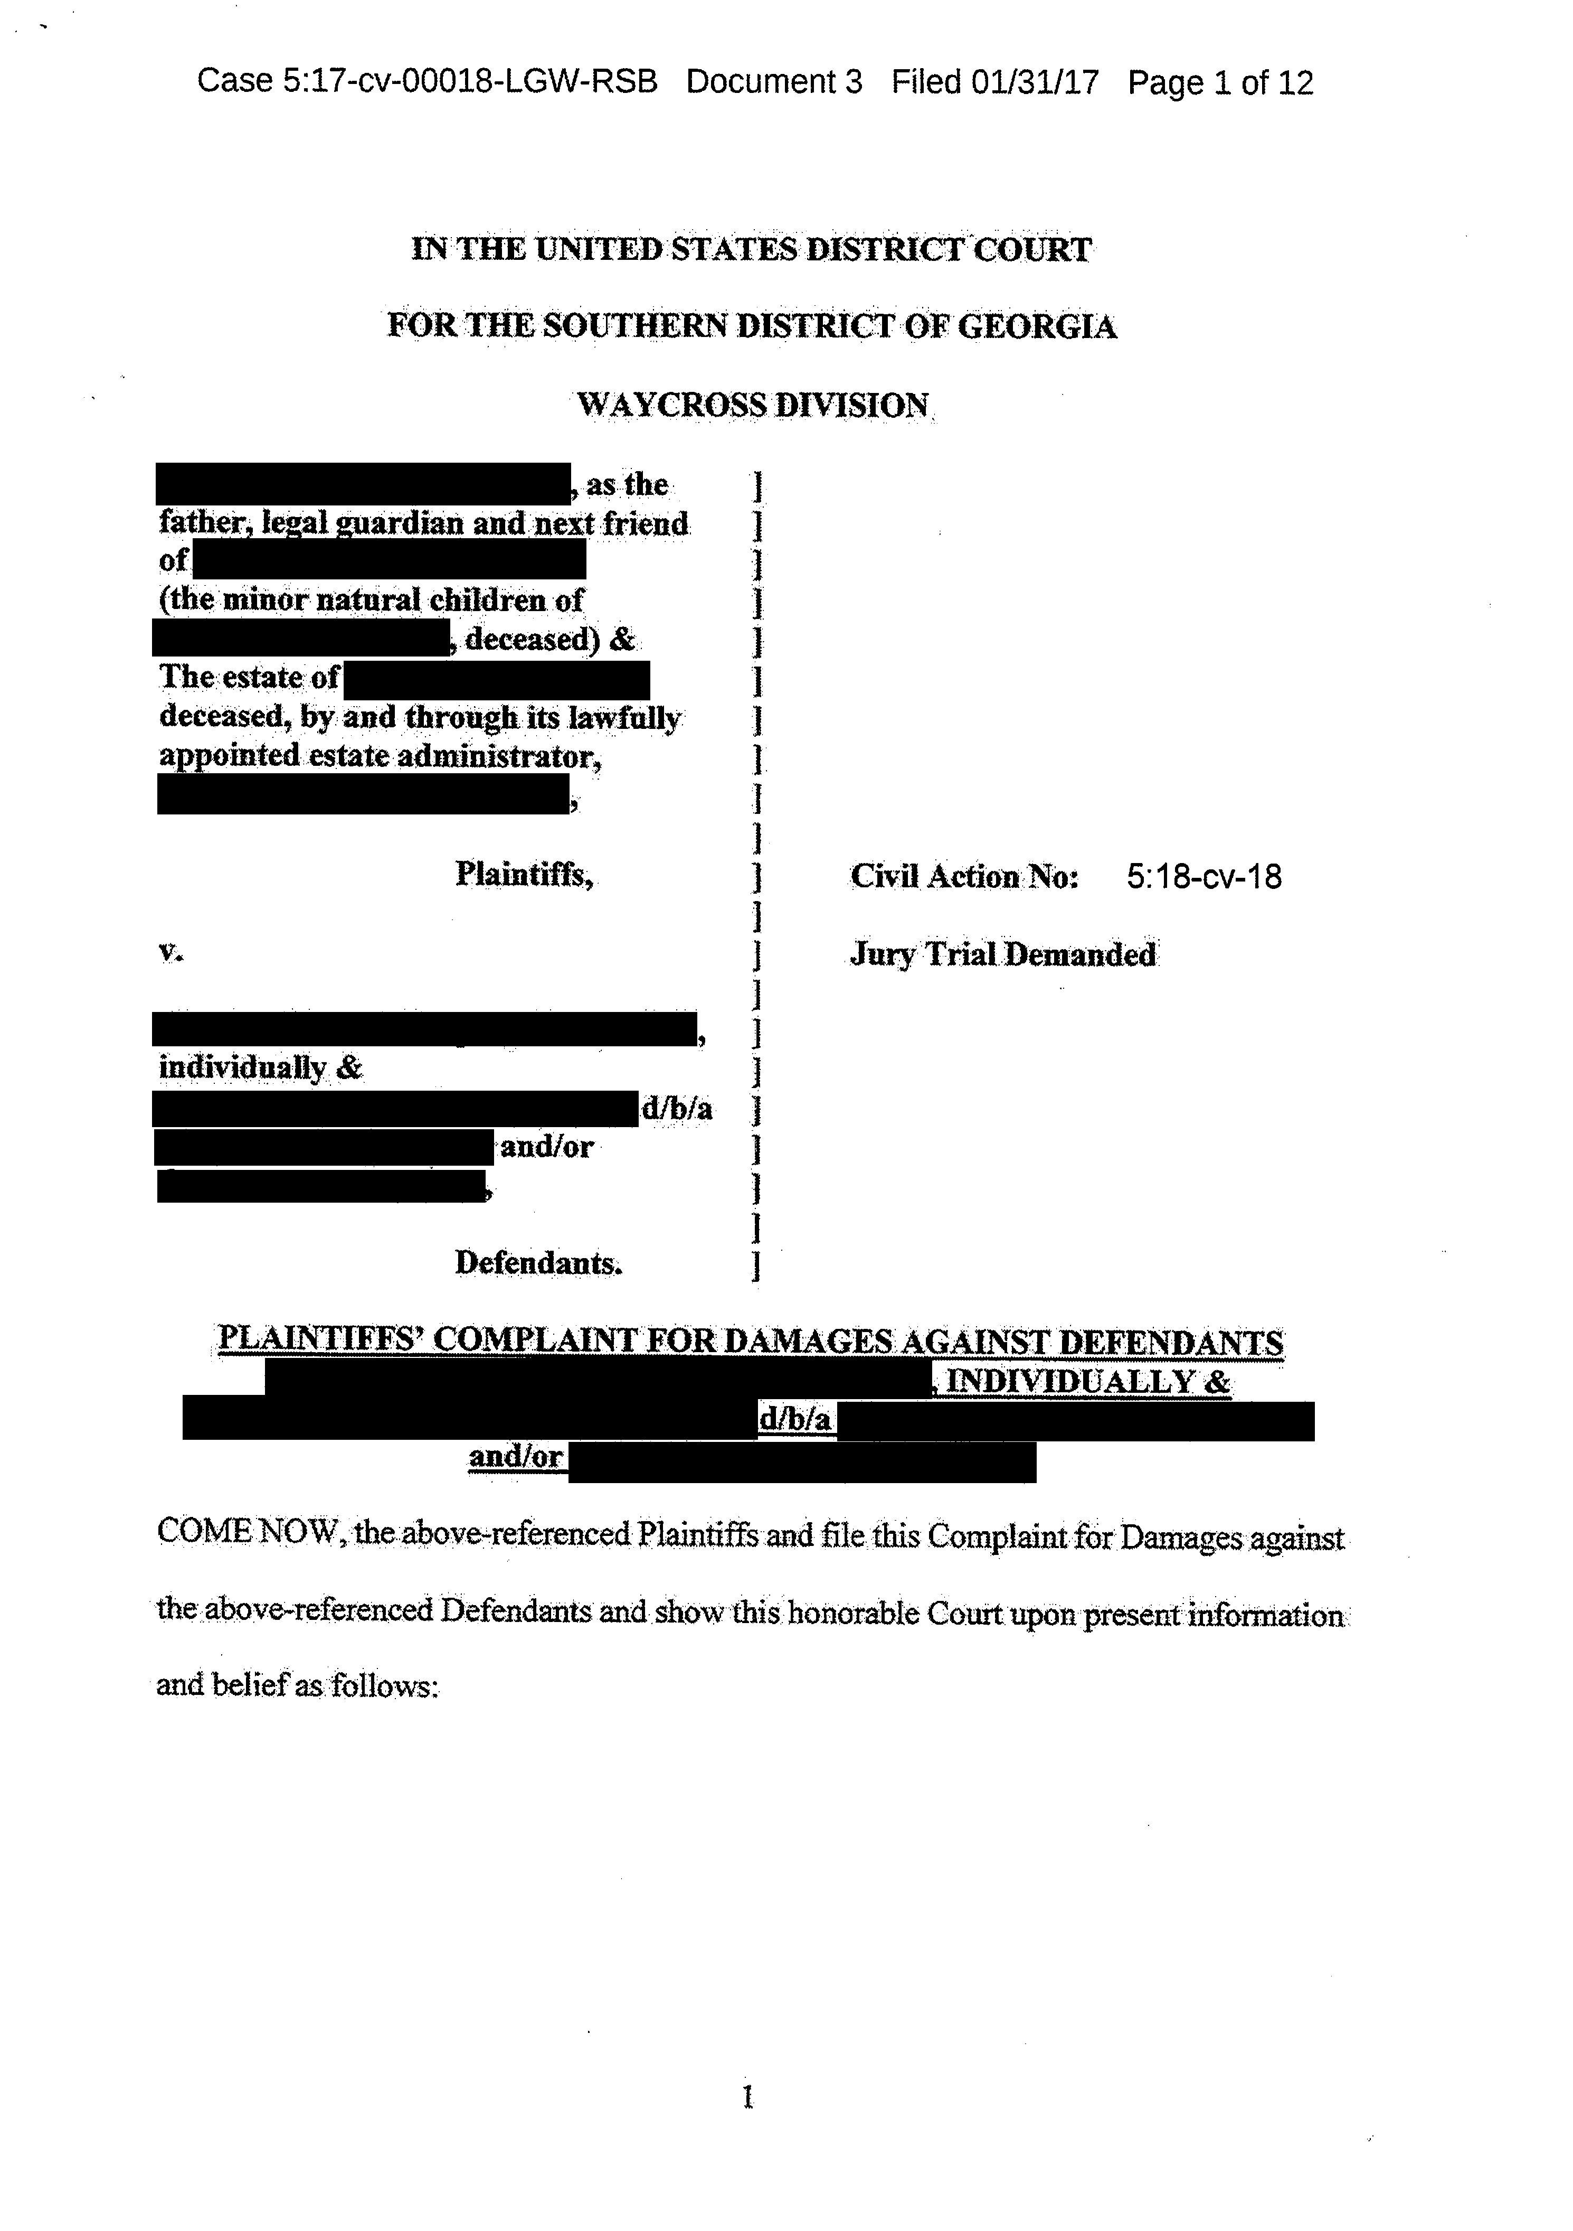

Slide 9
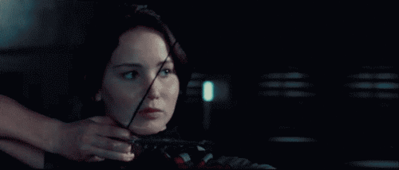
Are You Their Target?

Slide 10


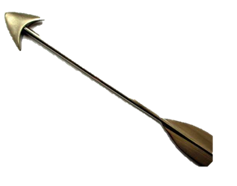


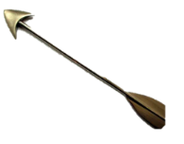
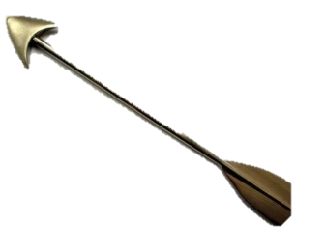
If you are seeing
patients, you are a
target?

Slide 11
What is leading to lawsuits
against oral surgeons??

Slide 12

FIREBALL

Slide 13

“A chaotic scene unfolded at the Ohio State Fair after a ride malfunctioned during opening day -- killing one person and injuring several others. Tragedy struck around 7:20 pm (local time) Wednesday at the popular fair in Columbus. The Fire Ball, which consists of at least six rows of seats that spin around 40 feet above the ground as the entire structure moves like a pendulum, broke apart while it was in motion.” (Steve Almasy and Nicole Chavez, CNN)

Slide 14
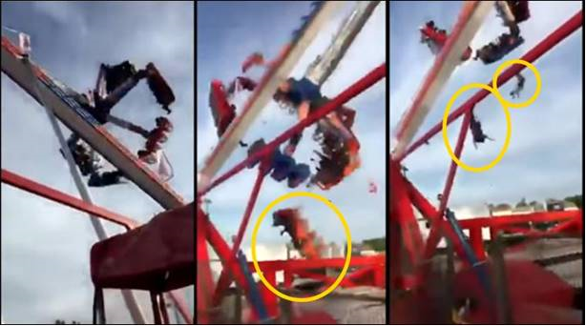
“Albert Kroon, product manager for the Dutch manufacturer, said in a statement that an investigation at the scene in Columbus determined that ‘excessive corrosion on the interior of the gondola support beam dangerously reduced the beam's wall thickness over the years.’ The ride was 18 years old. ‘This finally led to the catastrophic failure of the ride during operation,’ Kroon said.” (Janet DiGiacomo, CNN)

Slide 15
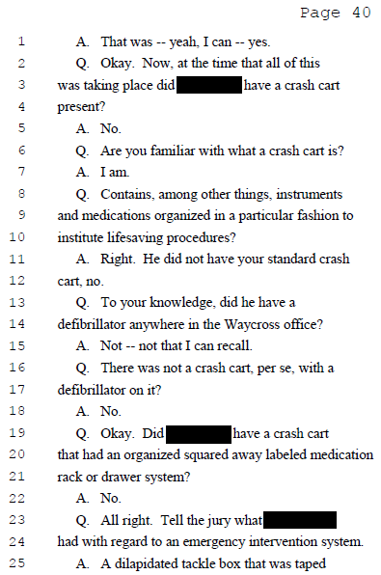
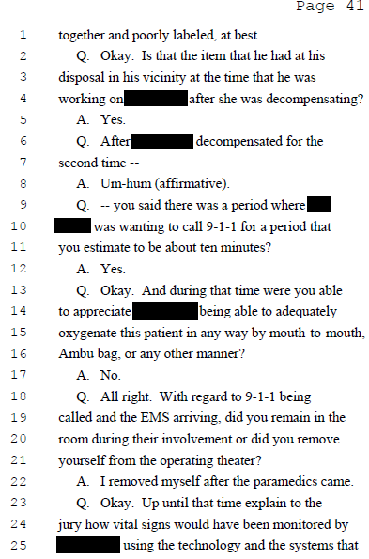
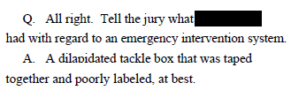

Slide 16
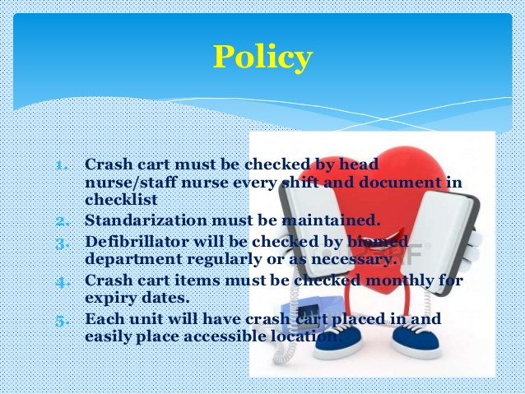
The Crash Cart
Is it easily accessible?
Is it organized?
Is it clean?
Is it well stocked?
Is it regularly maintained?
Is your staff familiar with your particular crash cart?

Slide 17
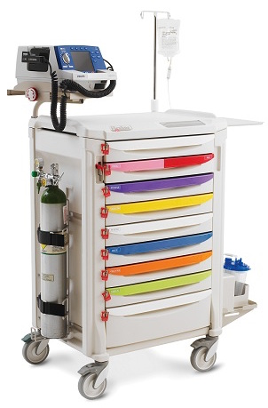
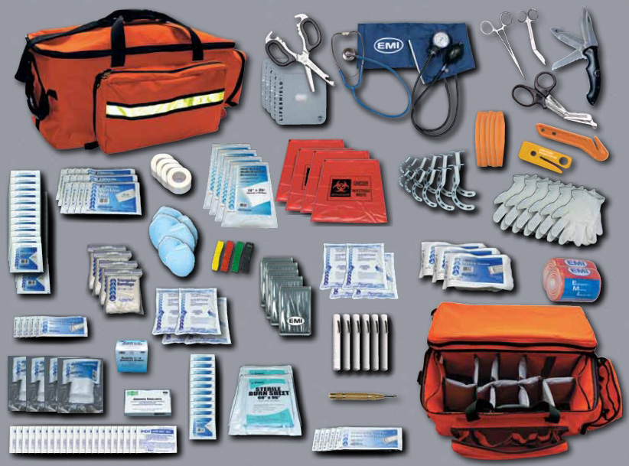
Your Equipment

Slide 18

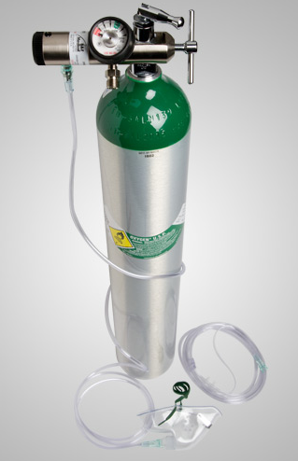
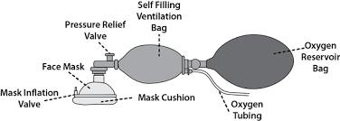
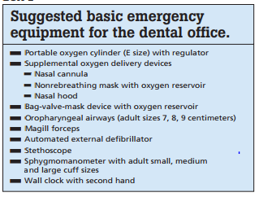
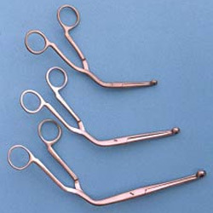

JADA, Vol. 141

Slide 19

Emergency Plan

Slide 20

What’s the Plan?
Who calls 911?
What information is communicated?
What is done with other patients/people in the office?
Who meets EMS at the door?
What information is provided to EMS on arrival?
What documentation is given to EMS?

Slide 21
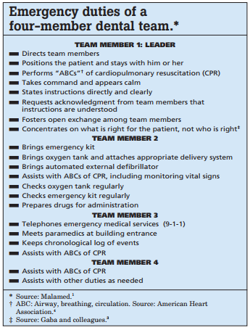
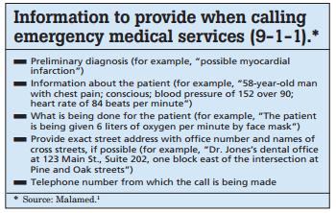

EXAMPLES

Slide 22

Your Team
Are your assistants credentialed?
Is their paperwork up to date?
  Do you check these items regularly?

Slide 23
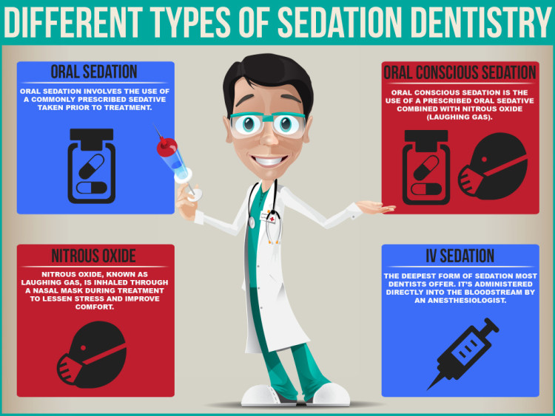
Sedation in Oral Surgery Offices

Slide 24
Who is watching YOUR
patient after the procedure is completed??

Slide 25
Issues concerning discharge:
  Does record establish suitability of discharge
  That someone (YOU) checked before patient walked

Slide 26
DO YOU WANT TO BE THE LOW HANGING FRUIT, THE SOFT TARGET?
OR, DO YOU WANT TO BE THE HARD TARGET?

Slide 27
Soft target is a military term referring to unarmored/undefended targets which are easily destroyed. For example, a soft target would be an automobile, a house or assembly of people in an open field while a hard target could be a tank or well defended installation. A soft target can generally be overcome from any direction.

Slide 28
Conduct that will affect the type of target you present:
1) What other doctors say/think of you; what your staff says/thinks of you.
2) What impression your office makes:
  on the telephone; visually; thru the people that represent you to your patients.

Slide 29

STAFF MUST BE FULLY PRESENT.
Notes:
Start at 17 seconds

Slide 30
3) What impression do YOU make:
  Do you radiate compassion?
  Do you convey competence?

Slide 31
THE FUNDAMENTALS
Provide Quality Care

Slide 32
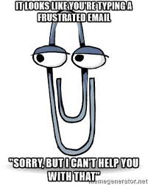

Slide 33
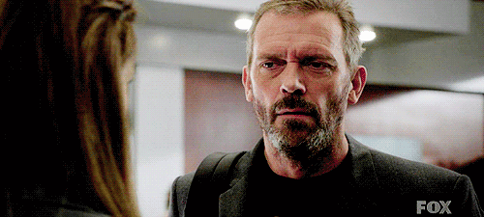
ATTITUDE WITH:
Patients
Family
Escort

Slide 34
ATTITUDE WITH:
      Other doctors

Slide 35
ATTITUDE WITH:
    Staff (yours and other offices)

Slide 36
Monitor your staff’s attitude
and your attitude,
constantly.

Slide 37

AN EFFECTIVE TEST
Someone you trust calls your office:
How is the phone answered?
Professionally? In a nice manner?

Slide 38
What impression do you leave when you interact with your patients/family members?
Are you engaged or are you doing the other person a favor?

Slide 39


Slide 40
PRESENTATION OF OFFICE
What is reasonable reaction to your office?

Slide 41
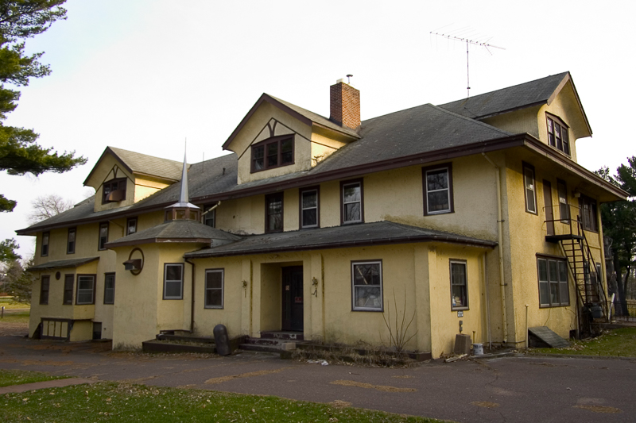
Does the
Exterior of your
Building worry
Patients???

Slide 42
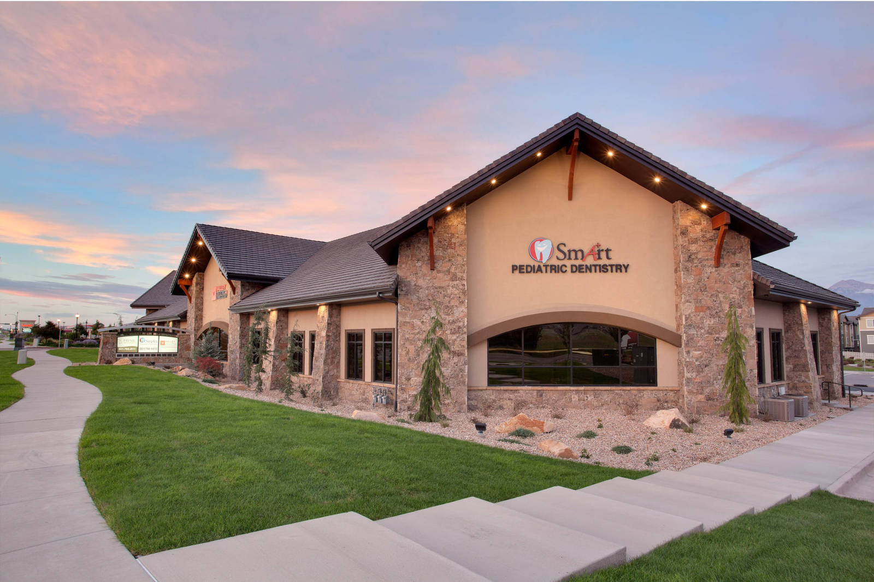
Or does it instill confidence and security?

Slide 43
What about the experience from inside?
What do your patients see and hear when in your office?

Slide 44
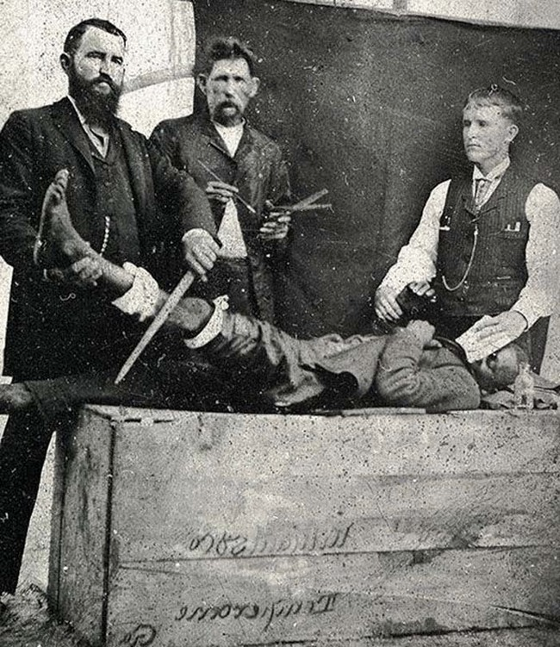

Slide 45
A 2009 survey conducted at outpatient clinics in New York City found a direct positive correlation between aesthetically appealing waiting rooms and patient opinions about their doctors’ visits.
The study asked 205 patients to rate their experience at seven clinics in the Weill Cornell Medical Center/New York Presbyterian Hospital system; the waiting rooms of each had previously and independently been ranked for attractiveness. Those who visited the attractive facilities reported better overall satisfaction with the quality of care received, their interactions with staff, and a reduction in anxiety. In addition, a comparison of actual time and patients’ perception of time spent waiting was underestimated by those who’d visited the attractive facilities and overestimated by those at the less attractive ones.

Slide 46
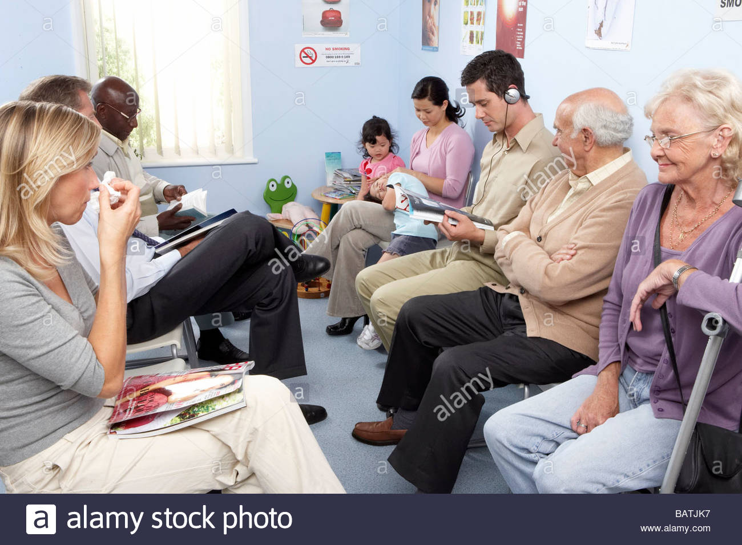

Slide 47
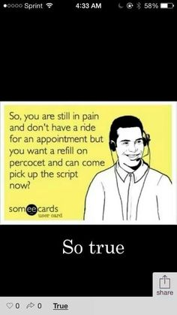

Slide 48
STRIVE TO WORK TOWARDS ONE GOAL
Does your office suggest that your office is providing quality professional care in a calm professional manner

Slide 49
STATUTORY DEFINITION OF STANDARD OF CARE
O.C.G.A. § 51-1-27 states the statutory standard for a medical malpractice action:
A person professing to practice surgery or the administering of medicine for compensation must bring to the exercise of his profession a reasonable degree of care and skill. Any injury resulting from a want of such care and skill shall be a tort for which a recovery may be had.

Slide 50
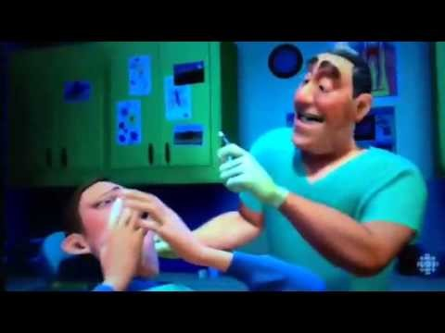

Slide 51
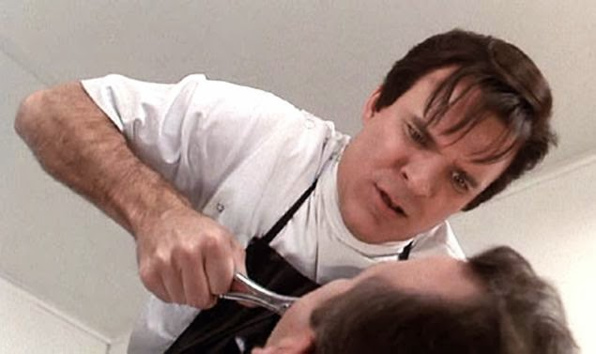
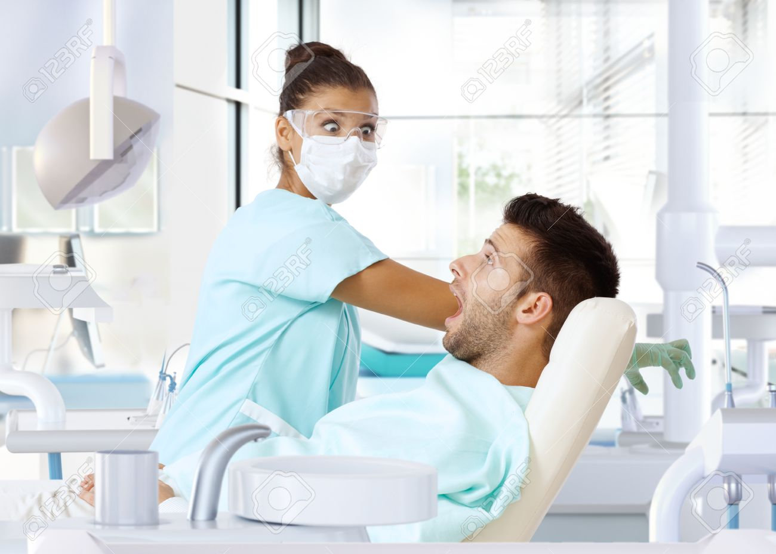
Remember, your facial expressions matter.

Slide 52
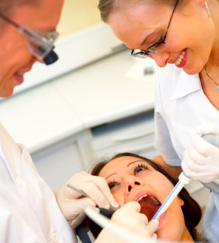

Slide 53
COMMUNICATION WITH PATIENTS/FAMILY/ESCORT
Clear
Confident/competent
Compassionate

Slide 54


Slide 55
ACCESSIBILITY
  Clear instructions on how you can be reached
  Do you respond: timely and professionally

Slide 56
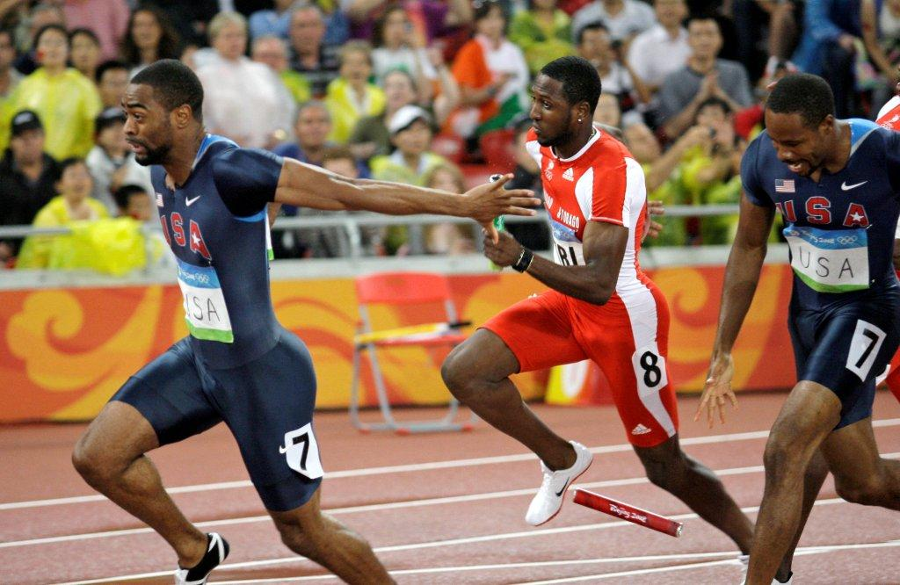
COMMUNICATION WITH REFERRALS
Don’t drop the “baton” during transfer!

Slide 57
    DOCUMENTATION

Slide 58
Does each patient’s record document:
  What treatment was provided/what in fact happened

Slide 59

  When Consent Is Required:
  Is it documented? legibly, in simple language, signed.
  Was a set protocol followed.

Slide 60
Are your entries clear and consistent?
Will you be able to explain what treatment you provided, and why, two years after the treatment was provided?
Do your records make you more or less of a target?

Slide 61
Speaking of consent form:
NEVER write “no alternatives to tx”

Slide 62
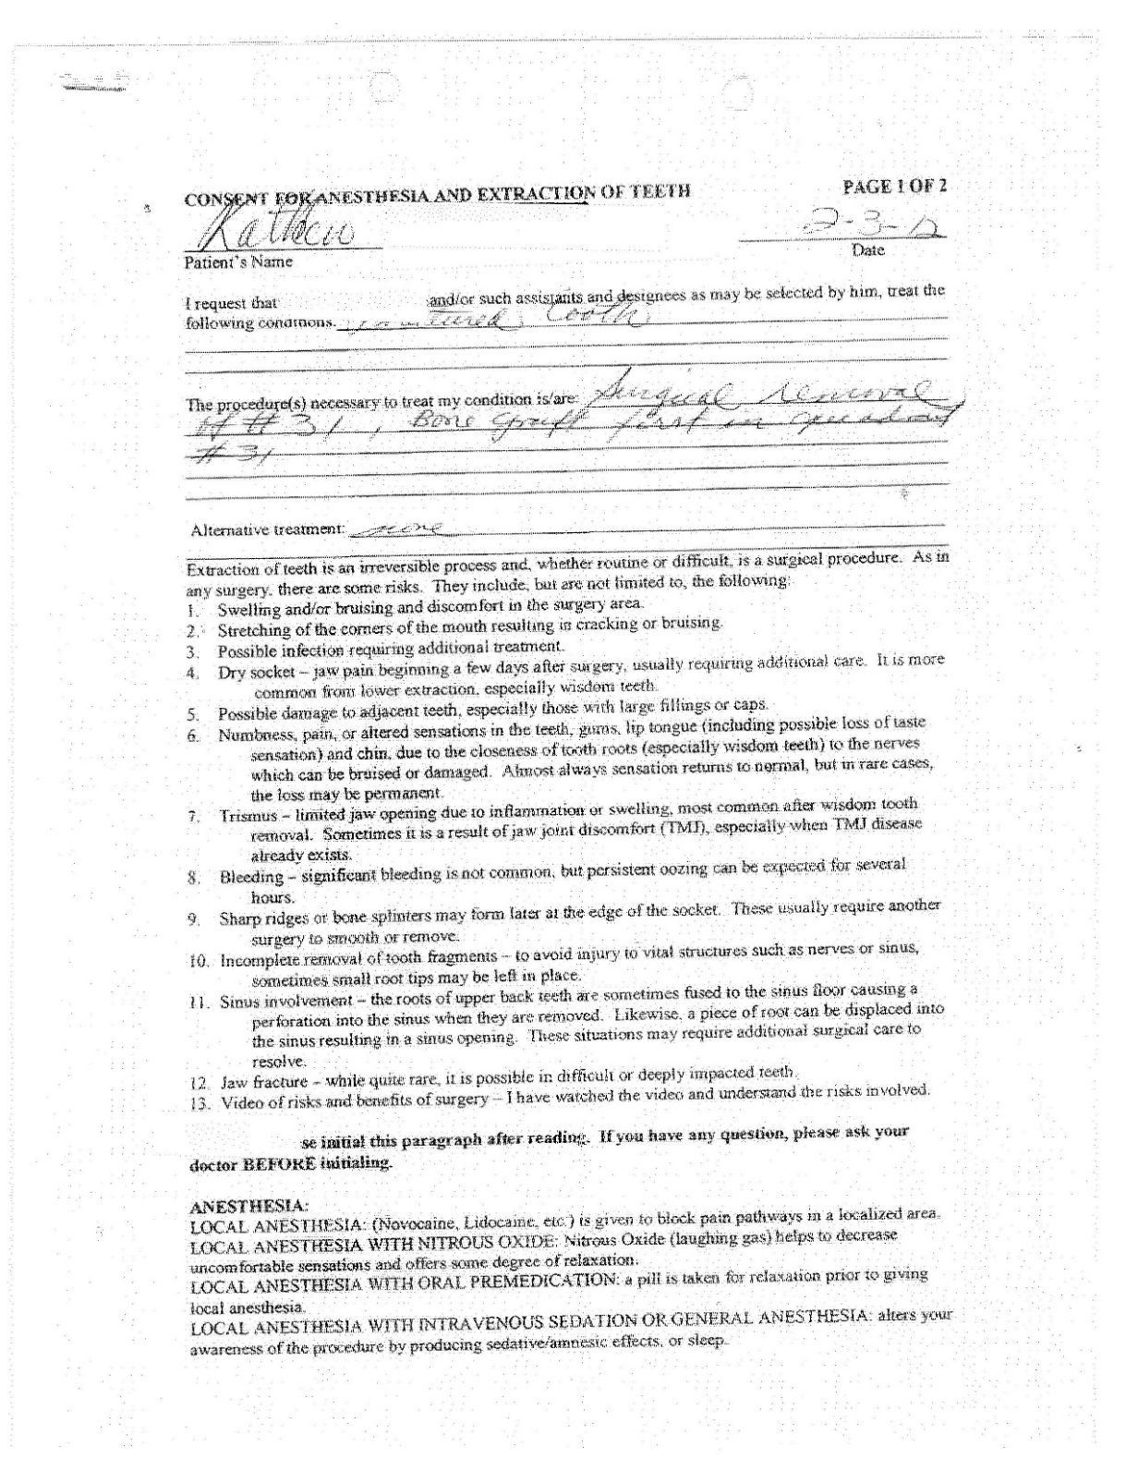

Slide 63
Is your record accurate??
  Have you checked the date/time on your monitors

Slide 64
YOU TOUCHED MY DAUGHTER!!!!
  Is someone always in room with you/staff when with patient

Slide 65
LIMIT PRACTICE TO WHAT YOU ARE COMPETENT AND COMFORTABLE DOING

Slide 66

LISTEN TO THAT 6TH SENSE

Slide 67
IF SUED, HOW TO HANDLE:
Calm, confident, cooperation with counsel.

Slide 68
OVERALL:
  BE NICE
  BE CARING
  BE PROFESSIONAL
  BE COMPETENT

